Slide 1
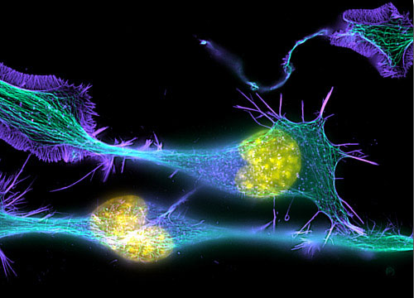
Introduction to
Light Microscopy
(Image: T. Wittman, Scripps)

Slide 2
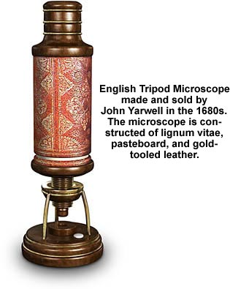
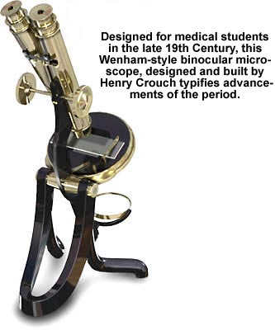
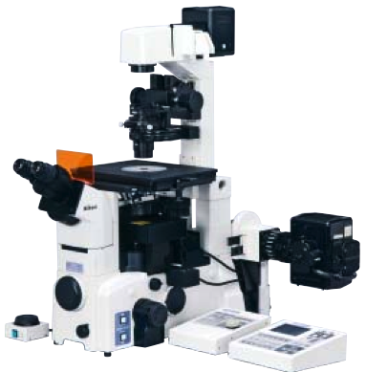
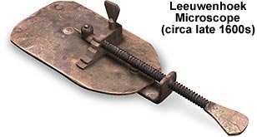
The Light Microscope
Four centuries of history
Vibrant current development
One of the most widely used research tools

Slide 3
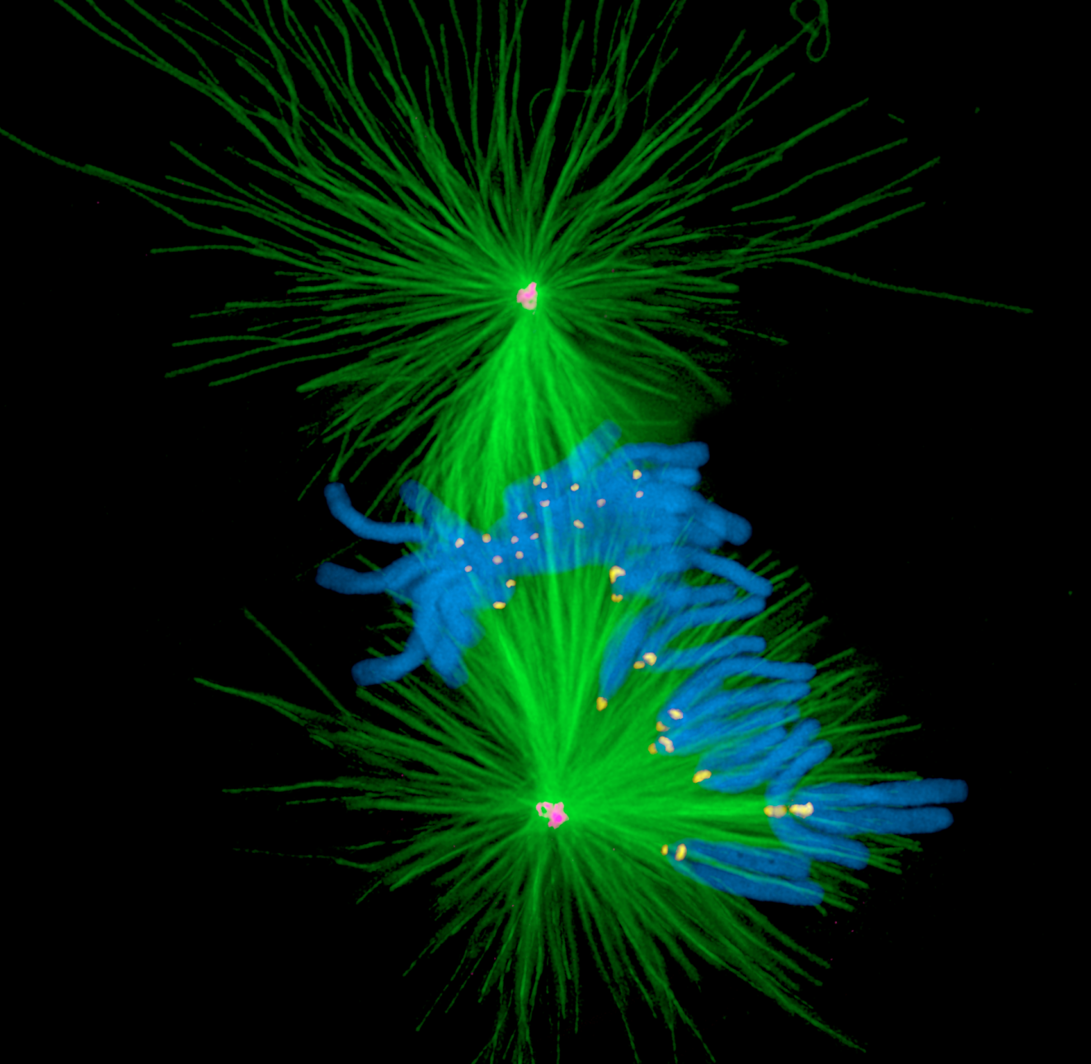
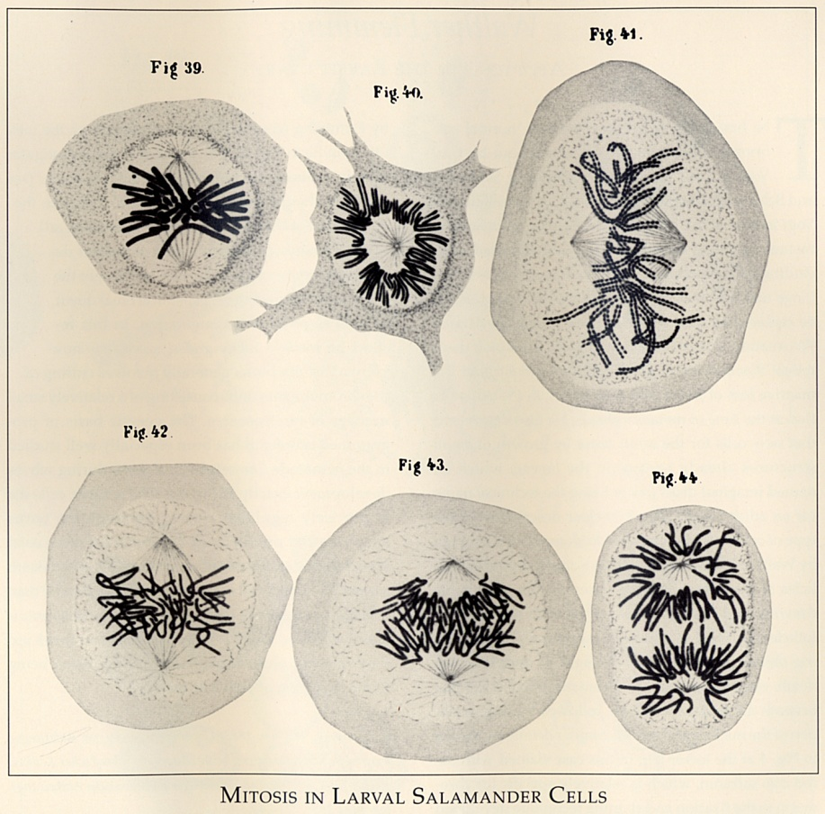
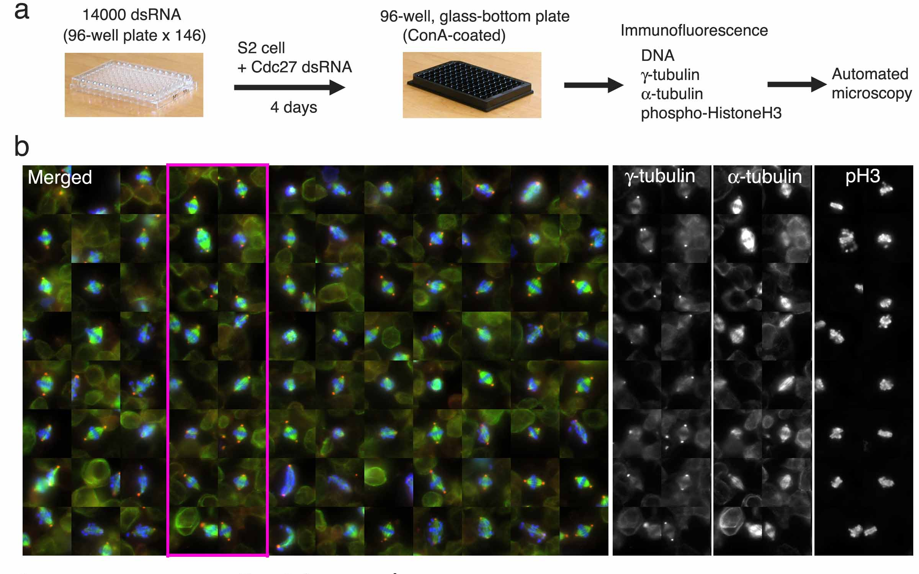
A. Khodjakov et al.

Slide 4
Major Imaging Functions of the Microscope
Magnify
Resolve features
Generate Contrast
Capture and Display Images

Slide 5
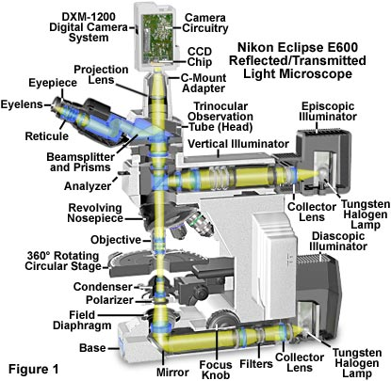
An Upright Epifluorescence Microscope

Slide 6
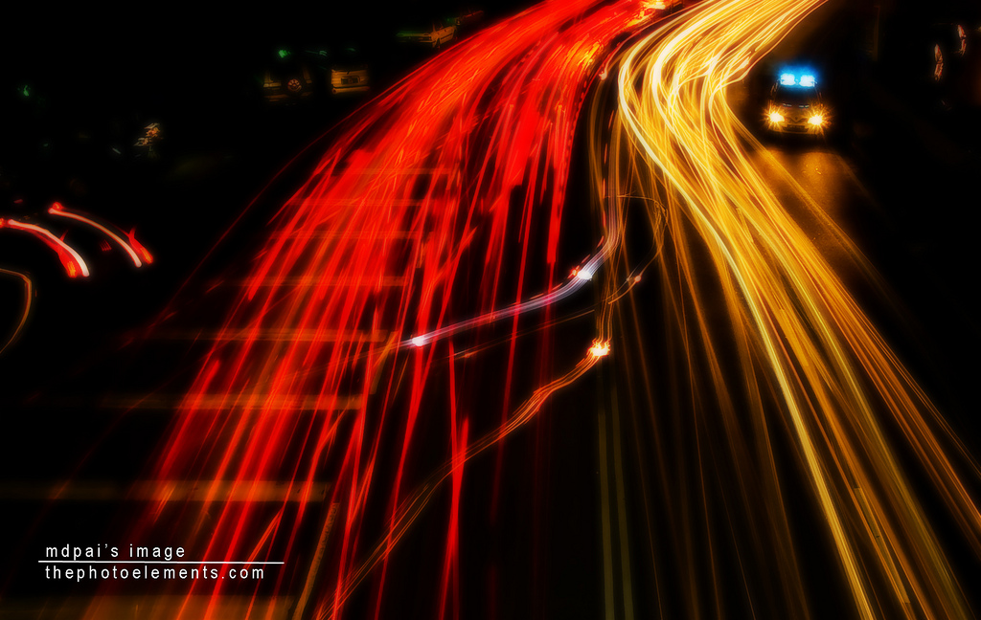
What is light?

Slide 7
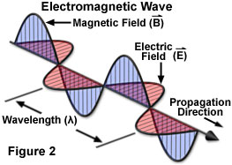
Waves vs. Photons vs. Rays
Quantum wave-particle duality
Rays: photon trajectories
Rays: propagation direction of waves

Slide 8
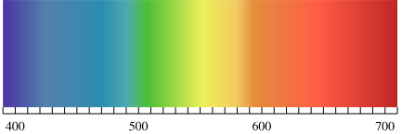
Wavelength and frequency
λ
c = λν
= 299792458 m/s in vacuum
ν = 10¹⁴ – 10¹⁵ Hz
Wavelength (nm)

Slide 9
Rays are perpendicular to wavefronts

Slide 10
Light travels more slowly in matter
The speed ratio is the Index of Refraction, n
v = c/n
n = 1
n > 1
n = 1

Slide 11
Refractive Index Examples
Vacuum 1
Air 1.0003
Water 1.333
Cytoplasm 1.35–1.38 ?
Glycerol 1.475 (anhydrous)
Immersion oil 1.515
Fused silica 1.46
Optical glasses 1.5–1.9
Diamond 2.417
Depends on wavelength and temperature

Slide 12
Refraction by an Interface
θ_{r}
Incident wave
Reflected wave
θ₁
Refractive index n₁ = 1
Speed = c
λ
Refractive index n₂
Speed = c/n
θ₂
Refracted wave
λ/n
⇒ Snell’s law:
Mirror law:
n₁ Sin(θ₁) = n₂ Sin(θ₂)
θ_{r} = θ₁

Slide 13
Which Direction?
n₁
n₂ > n₁
Refraction goes
towards the normal
in the higher-index medium

Slide 14
Lenses work by refraction
Incident light
focus
Focal length f

Slide 15
Ray Tracing Rules of Thumb (for thin ideal lenses)
Parallel rays converge
at the focal plane
Rays that cross in the focal plane
end up parallel
f
f
Rays through the lens center are unaffected

Slide 16
Imaging
f
Image
Object
d₁
d₂
L₁
L₂
The lens law:
Magnification:

Slide 17
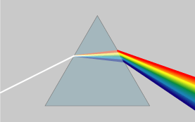
Dispersion
Refractive index is wavelength dependent

Slide 18

Dispersion

Slide 19
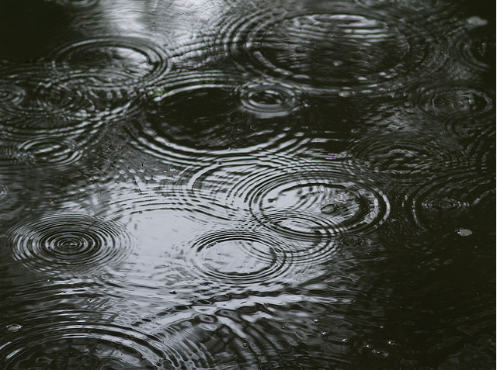
Diffraction and interference

Slide 20
Diffraction

Slide 21
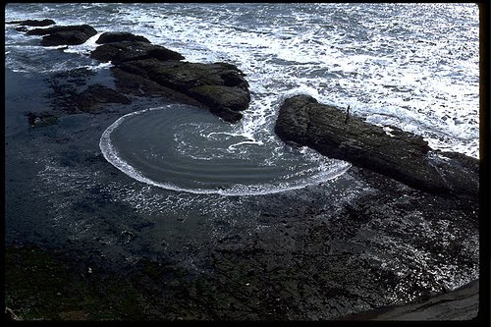
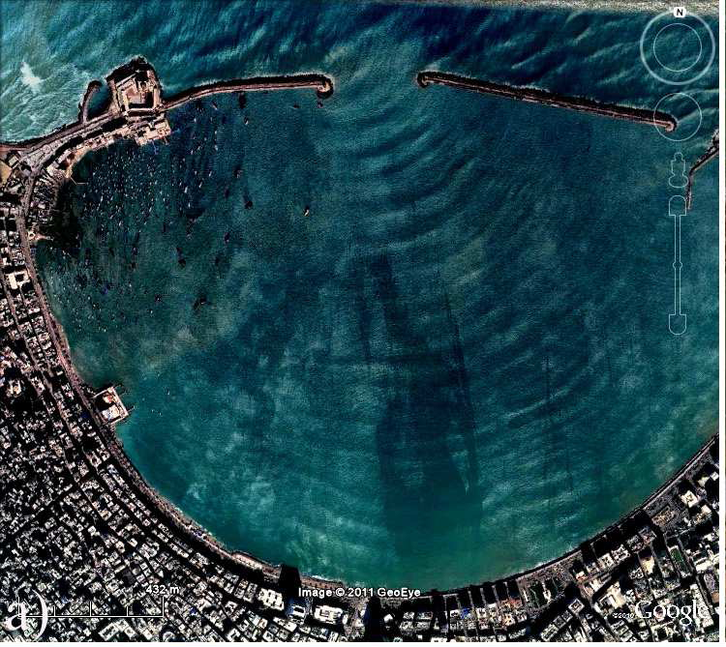
Diffraction by an aperture
See “Teaching Waves with Google Earth” http://arxiv.org/pdf/1201.0001v1.pdf for more

Slide 22
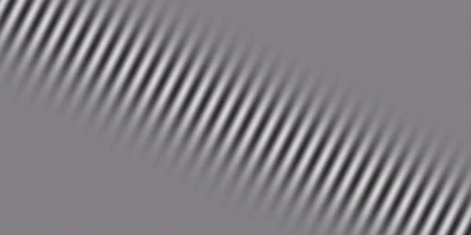
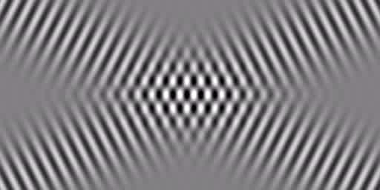
Interference

Slide 23
Constructive interference
Δφ
+
=

Slide 24
Destructive interference
Δφ
+
=

Slide 25
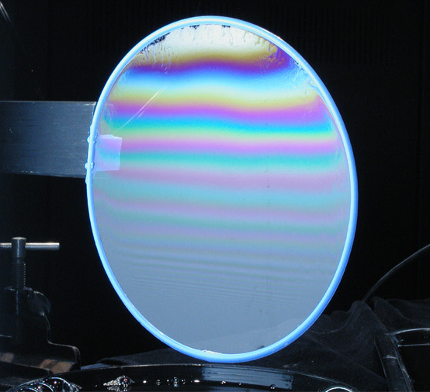
Thin film interference
harvard.edu
Δφ

Slide 26
Light propagation = diffraction + interference

Slide 27
Light propagation = diffraction + interference
A_{i}
l_{i}
A = Σ A_{i} sin(2πl/λ)
I = A²

Slide 28
Double slit interference
d

Slide 29
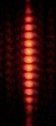
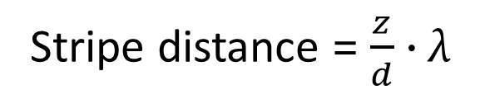
Double slit interference
θ
x
d
z
Δ = d sinθ ≈ dx/z
Δ = kλ for constructive interference
Stripe distance = $\frac{z}{d}$ ∙ λ

Slide 30
Diffraction by a periodic structure (grating)

Slide 31
Diffraction by a periodic structure (grating)
θ
θ
d
d Sin(θ)
In phase if:
d Sin(θ) = m λ
for some integer m

Slide 32
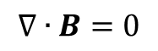
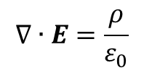
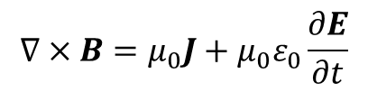
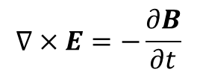
Light as electromagnetic waves
Maxwell’s equations
$$∇∙E=\frac{ρ}{ε_{0}}$$
$$∇∙B=0$$
$$∇×E=−\frac{∂B}{∂t}$$
$$∇×B=μ_{0}J+μ_{0}ε_{0}\frac{∂E}{∂t}$$

Slide 33
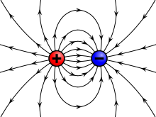

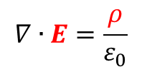
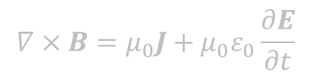
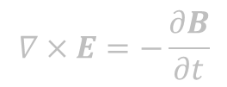
Light as electromagnetic waves
Maxwell’s equations
$$∇∙E=\frac{ρ}{ε_{0}}$$
Charge density
Static electric field generated by charges
$$∇∙B=0$$
Electric field
$$∇×E=−\frac{∂B}{∂t}$$
$$∇×B=μ_{0}J+μ_{0}ε_{0}\frac{∂E}{∂t}$$
wikipedia

Slide 34
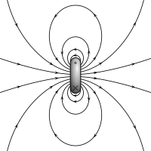
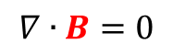
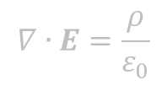
Light as electromagnetic waves
Maxwell’s equations
$$∇∙E=\frac{ρ}{ε_{0}}$$
$$∇∙B=0$$
Magnetic force lines form closed circles.
$$∇×E=−\frac{∂B}{∂t}$$
Magnetic field
$$∇×B=μ_{0}J+μ_{0}ε_{0}\frac{∂E}{∂t}$$
wikipedia

Slide 35
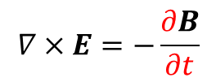
Light as electromagnetic waves
Maxwell’s equations
$$∇∙E=\frac{ρ}{ε_{0}}$$
$$∇∙B=0$$
$$∇×E=−\frac{∂B}{∂t}$$
A changing magnetic field generates electric field
$$∇×B=μ_{0}J+μ_{0}ε_{0}\frac{∂E}{∂t}$$
Rate of change

Slide 36
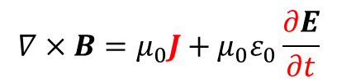
Light as electromagnetic waves
Maxwell’s equations
$$∇∙E=\frac{ρ}{ε_{0}}$$
$$∇∙B=0$$
$$∇×E=−\frac{∂B}{∂t}$$
$$∇×B=μ_{0}J+μ_{0}ε_{0}\frac{∂E}{∂t}$$
Electric current and changing electric field generate magnetic field
Electric current

Slide 37

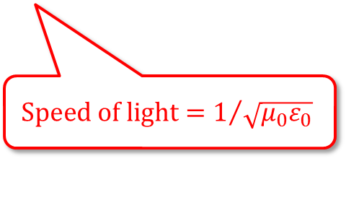
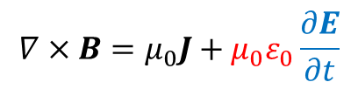
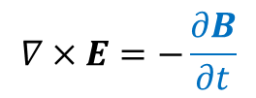
Light as electromagnetic waves
Maxwell’s equations
$$∇∙E=\frac{ρ}{ε_{0}}$$
$$∇∙B=0$$
$$∇×E=−\frac{∂B}{∂t}$$
$$∇×B=μ_{0}J+μ_{0}ε_{0}\frac{∂E}{∂t}$$
Michael Davidson
$${Speed of light=1}/{\sqrt{μ_{0}ε_{0}}}$$

Slide 38
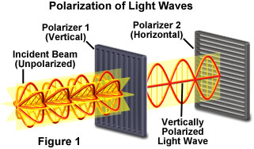
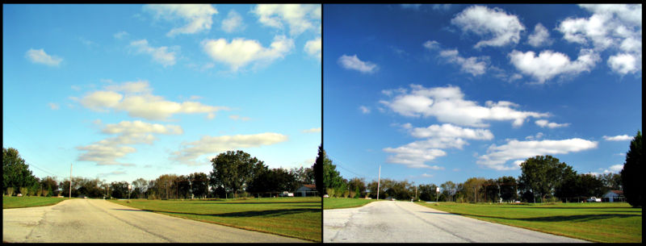
Polarization
Michael Davidson
wikipedia

Slide 39
What about energy?
Classically, the energy of light was just the amplitude of the electric and magnetic fields.
But this led to problems….

Slide 40
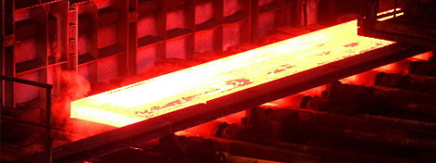
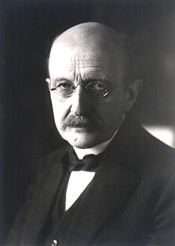
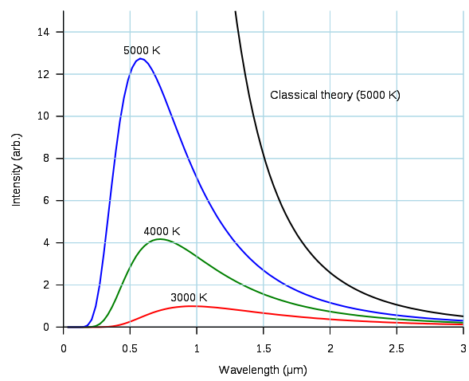
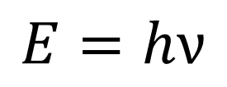
Blackbody emission and the UV catastrophe
Max Planck
$$E=hν$$

Slide 41
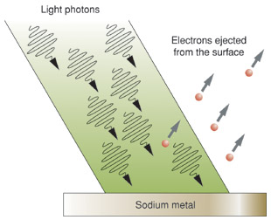
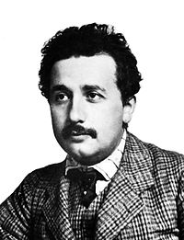
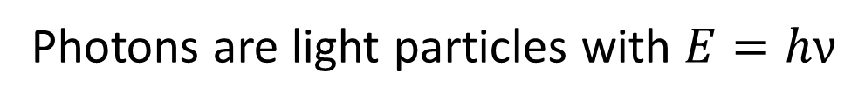
Photoelectric effect
Photoelectrons
Albert Einstein
hν
hν
hν
hν
hν
hν
hν
hν
The Encyclopedia of Science
Photons are light particles with $E=hν$

Slide 42
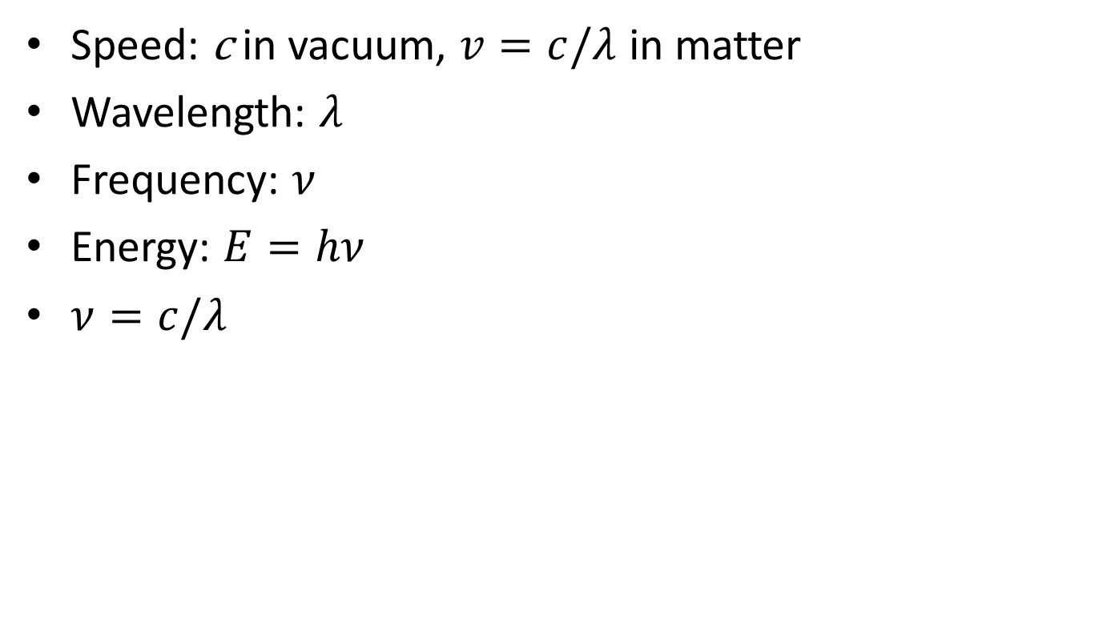
Properties of Light
Speed: c in vacuum, $v=c/λ$ in matter
Wavelength: $λ$
Frequency: $ν$
Energy: $E=hν$
$ν=c/λ$

Slide 43
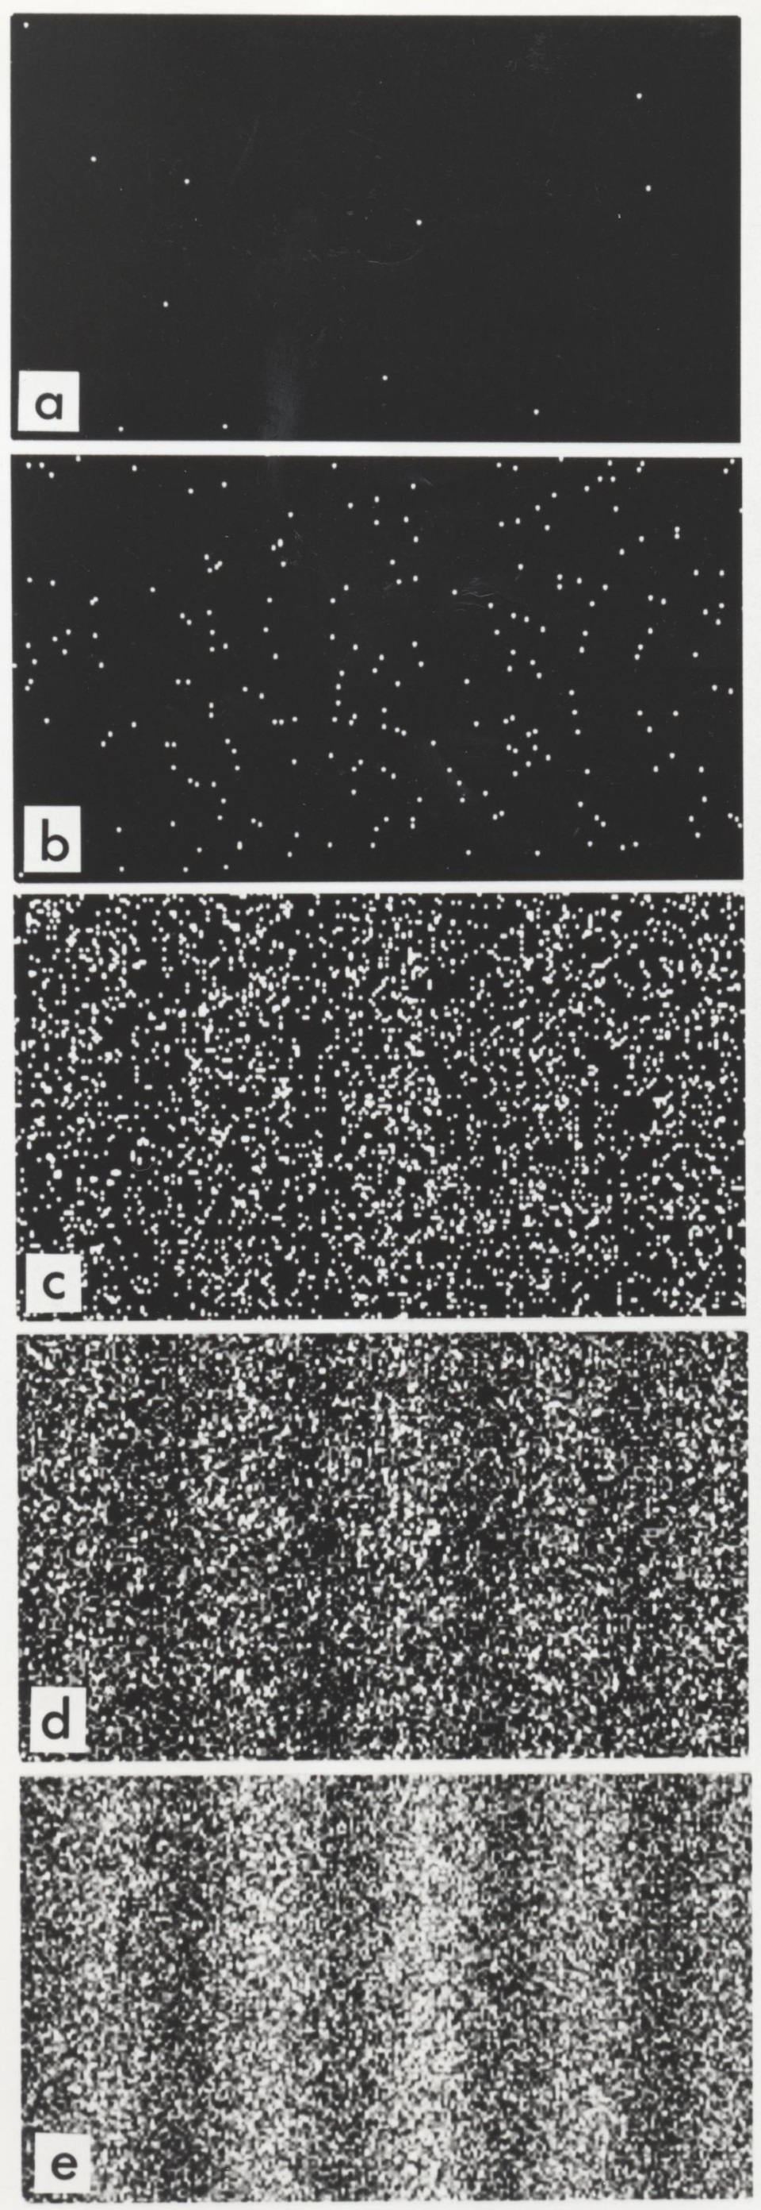
Wave-particle duality
Double-slit experiment of electrons
11 electrons
200 electrons
6000 electrons
40000 electrons
140000 electrons
Akira Tonomura, PNAS, 2005

Slide 44
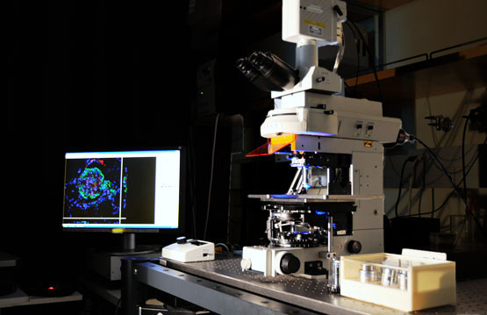
Back to Microscopy

Slide 45
Imaging
f
Image
Object
d₁
d₂
L₁
L₂
The lens law:
Magnification:

Slide 46
Finite vs. Infinite Conjugate Imaging
Finite conjugate imaging (older objectives)
Image
f₀
Object
>f₀
f₀
Infinite conjugate imaging (modern objectives).
Image at infinity
f₁
⇒ Need a tube lens
Image
f₀
Object
f₀
f₀
(uncritical)
f₁
Magnification:

Slide 47
Back focal plane
Back focal plane
f₀
Object
f₀
f₀
Rays that leave the object with the same angle
meet in the objective’s back focal plane

Slide 48
The Compound Microscope
Exit pupil
Eyepiece
Primary or intermediate
image plane
Tube lens
Back focal plane (pupil)
Objective
Sample
Object plane

Slide 49
The Compound Microscope
Final image
Eye
Exit pupil
Eyepiece
Intermediate image plane
Tube lens
Back focal plane (pupil)
Objective
Sample
Object plane

Slide 50
The Compound Microscope
Final image
Eye
Exit pupil
Eyepiece
Intermediate image plane
Tube lens
Back focal plane (pupil)
Objective
Sample
Object plane

Slide 51
The Compound Microscope
Final image
Eye
Exit pupil
Eyepiece
Intermediate image plane
Tube lens
Back focal plane (pupil)
Objective
Sample
Object plane

Slide 52
The Compound Microscope
Final image
Eye
Exit pupil
Eyepiece
Intermediate image plane
Tube lens
Back focal plane (pupil)
Objective
Sample
Object plane

Slide 53
The Compound Microscope
Camera
Final image
Secondary pupil
Projection Eyepiece
Intermediate image plane
Tube lens
Back focal plane (pupil)
Objective
Sample
Object plane

Slide 54
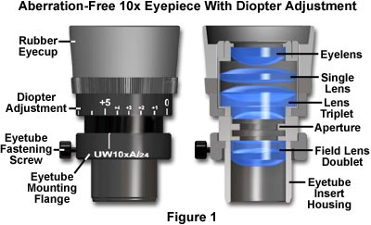
Eyepieces (Oculars)
Features
Magnification (10x typical)
“High eye point” (exit pupil high
enough to allow eyeglasses)
Diopter adjust (at least one
must have this)
Reticle or fitting for one
Eye cups

Slide 55
Trans-illumination Microscope
Camera
Final image plane
Secondary pupil plane
Projection Eyepiece
Imaging
path
Intermediate image plane
Tube lens
Back focal plane (pupil)
Objective
Sample
Object plane
Condenser lens
The aperture iris
controls the range of
illumination angles
Aperture iris
(pupil plane)
Illumination
path
Field lens
Field iris
(image plane)
The field iris
controls the
illuminated
field of view
Collector
Light source
(pupil plane)

Slide 56
Köhler Illumination
Critical Illumination
Sample
Object plane
Aperture iris
(pupil plane)
Field iris
(image plane)
Light source
(pupil plane)
Each light source point produces a parallel beam of light at the sample
Uniform light intensity at the sample even if the light source is “ugly” (e.g. a filament)
The source is imaged onto the sample
Usable only if the light source is perfectly uniform

Slide 57

Conjugate Planes in A Research Microscope

Slide 58
How view the pupil planes?
Two ways:
“Eyepiece telescope”
“Bertrand lens”

